Slide 1

“Grocery Delivery
Website”
Task - 1

Slide 2
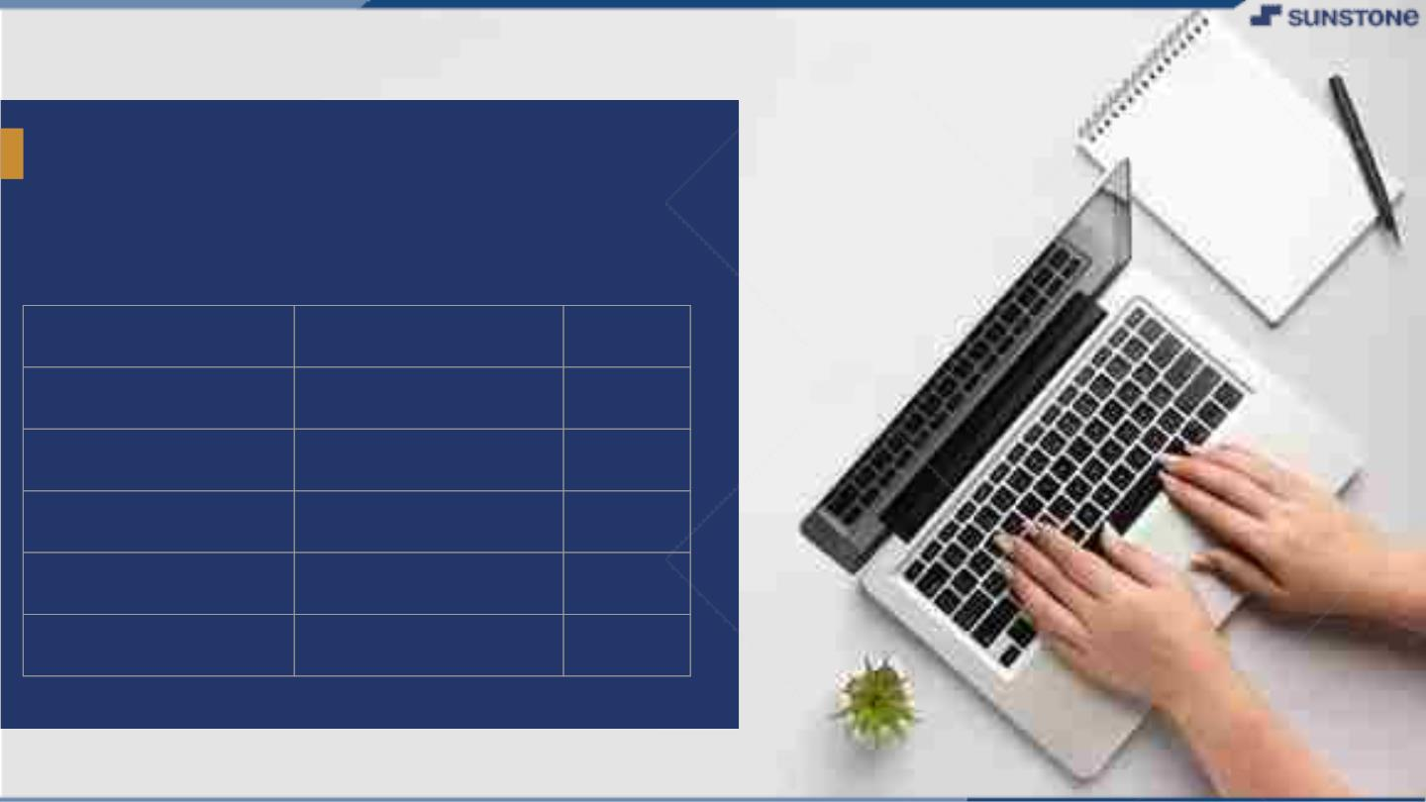
GroceryꢀDeliveryꢀWebsite
LMS Username
2108a33281
2108a33286
2108a33297
2108a33300
Name
Lavanya T
Batch
A33
Monisha A
A33
Sherin Rebecca S
Sunil R
A33
A33

Slide 3
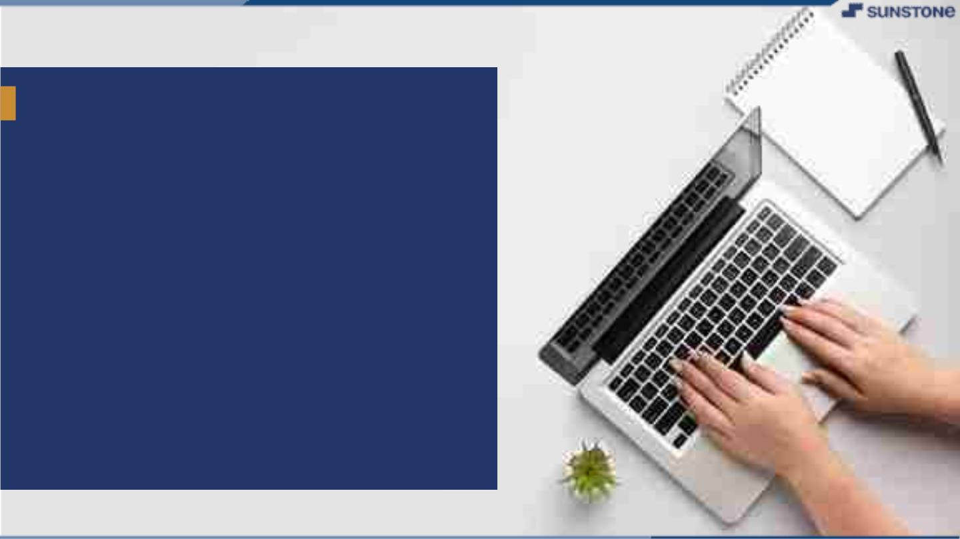
Grocery Delivery Website
▪
Purpose
The purpose of developing Grocery
Delivery Website is to provide services for
the customer through a single gate way
using the internet.
In the Web application customer to
search through the shop and purchase
online without to visit the shop.

Slide 4
Grocery Delivery Website
▪
Scope
This website allows to the customer's
maintaining cart for add or remove the
product over the internet.
As a grocery delivery project, it has a
lot of scope in the commercial field. Since
everything is now available at everybody's
doorstep so a project like this is very much
viable in the future.

Slide 5
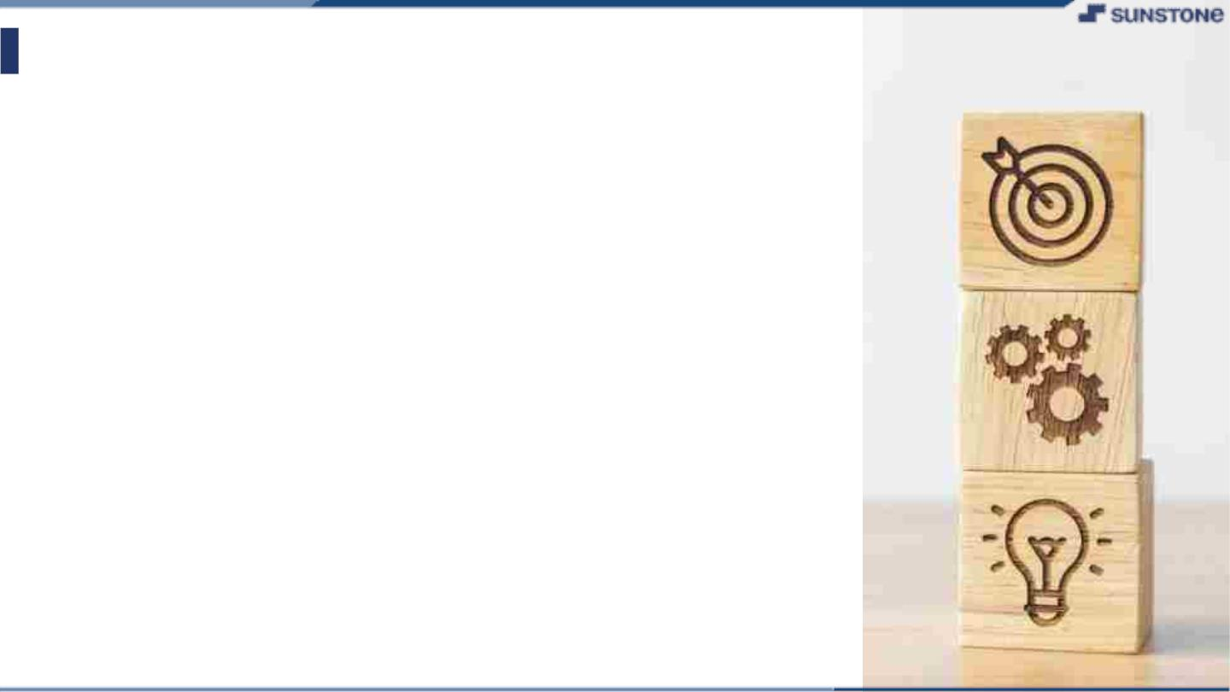
SRS for “Grocery Delivery Website"
▪ Functional Requirements
A functional requirement defines a function of a system or
its components. Functional requirements may be calculation,
technical details, data manipulation and processing and other
specific functionality.
There are various functional modules:-
▪
▪
▪
User registration
New user can register .
Customer login
Register user can login.
Search
User search product by product name or category or brand
name.
Product order
▪
▪
Customer order products and make payment by cash or
delivery or through Banking and admin will confirm or pending
or cancel.
Chart
Customer saves their chosen option in cart.

Slide 6
SRS for “Grocery Delivery Website”
▪ Functional Requirements
▪
Product order
Customer order products and make payment by cash or delivery or
through Banking and admin will confirm or pending or cancel.
▪
Feedback
Customer give feedback about products or any other and
admin view it.
▪
▪
▪
▪
Admin registration
Admin can register.
Admin login
Registered customer can login and manage the whole.
Logout
After ordering or surfing for the product customer has to logout.
Report Generation
After ordering for the product , the system will sent one copy of the
bill to the customer’s Email-address and another one for the system data
base.

Slide 7
SRS for “Grocery Delivery Website"
▪ Non Functional Requirements
▪
▪
Security
The system use security socket in all transactions. The
system must automatically logout all customers after periods
of Inactivity.
Reliability
The system provides storage of all database on redundant
computers. The reliability of the overall program depends on
the reliability of the separate components. The main pillar of
the system is the back-up of the database.
Portability
The effort requires to move the software to a different
target platform. A user is using this system on any OS; either
it is window or Linux. The system shall run on PC, laptop etc.
Maintainability
▪
▪
A database is used for maintaining the database and
the application server take care of site. In case of failure of
the program, a re- initialization of the program will be done.

Slide 8
SRS for “Grocery Delivery Website”
▪
Performance Requirements
In order to maintain an acceptable speed at maximum number of
can access to the system at any time.
Also the connections to the servers will be based on the
attributes of the user like his location and server will be working 24X7
times.
Uploads allowed from a particular customer as any number of
users.
▪
Technical Issues
This system will work on client-server architecture.
It will require an internet server and which will be able to run
PHP application.
The system should support some commonly used browser such
as IE , mozzila firefox , chrome etc.

Slide 9
SRS for “Grocery Delivery Website"
▪ General Description
▪
User interface
An interface system screen will be displaying
information about product that shop having. If customer
select button then screen of shopping site will be open.
Customer can be log in after log in purchase any item
without log in customer or visitor cannot purchase any
item only that can see product.
▪
Communicate interface
The software written in English so user must know
English language. User can communicate software in
English language.

Slide 10
SRS for “Grocery Delivery Website"
▪ Software Requirements
▪
▪
▪
Operating System
Linux, Windows 10/7/8.1/8
Font-end Tool
PHP, Java script
Back-End
MY SQL

Slide 11
SRS for “Grocery Delivery Website"
▪ Hardware Requirements
▪
▪
▪
▪
▪
▪
Processor
Pentium 2.4 GHZ or above.
Memory
2 GB RAM.
Cache Memory
128 KB or above.
Printer
Laser Printer.
Pen Drive
4GB.
Hard Disk
500 GB.

Slide 12
SRS for “Grocery Delivery Website"
▪ Description
▪
▪
▪
Grocery Delivery Website Project involves creating a website or
mobile app that allows customers to place orders for groceries
on- line.
The website or app must be user-friendly and easy to navigate,
with clear categories for different types of products, such as
fresh produce, meats, dairy, and dry goods.
Customers should be able to easily add items to their shopping
cart, specify quantities, and make payment securely.

Slide 13
SRS for “Grocery Delivery Website"
▪ Summary
▪
In the online shopping system the users of the system are
searching for grocery products, registration their
information like name address phone number etc.
The user after registration can add to cart product and buy
products.
Date and time of product delivery will be notified by the
system when admin confirm order.
Customer can choose various payment methods like cash
on delivery, Net Banking, Debit/Credit card.
Customer can return if he/she received any defective
product.
▪
▪
▪
▪
▪
The admin can add/delete/search product and also can
confirm or cancel order.

Slide 14
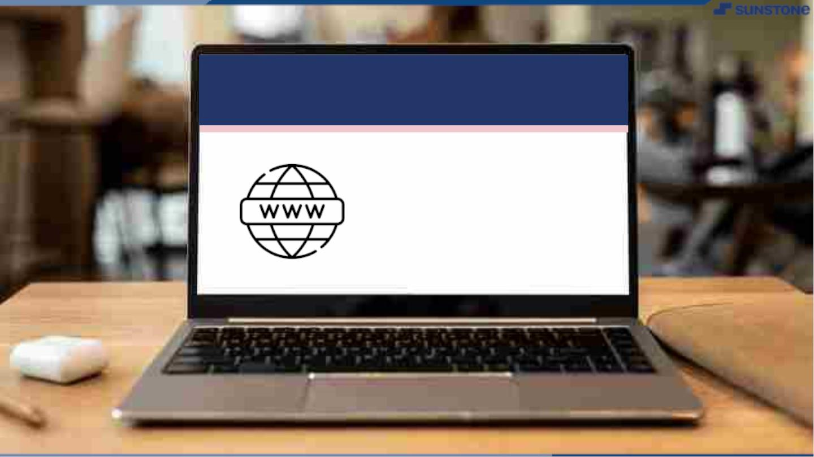
Submission Github
https://github.com/Lava2910/lavaA33
Your github should contain this ppt,
readme file.

Slide 15


